Slide 1
Lecture №6
Prepared by Norkin Mark and Prokofyev Mikhail

Slide 2
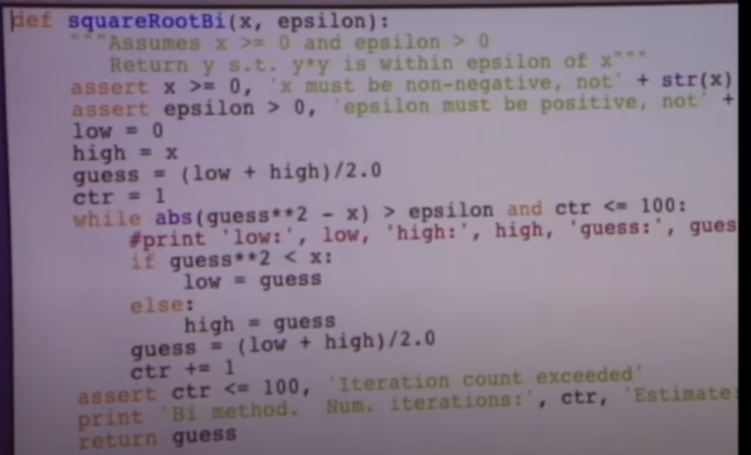
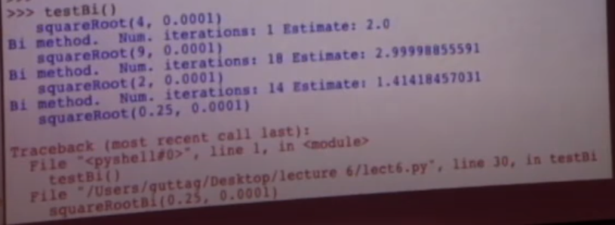
Bisection method bug

Slide 3
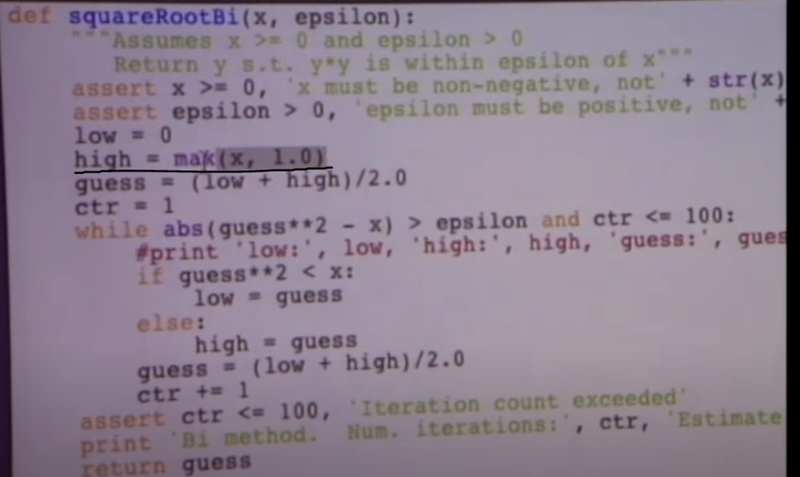
Fixing a bug

Slide 4
Newton’s method
f(guess)= guess² – x
f(guess)=0
To find the root of this equation, you can choose a guess according to the following rule
guess_{i+1} = guess_{i} - f(guess_{i})/(2* guess_{i})

Slide 5
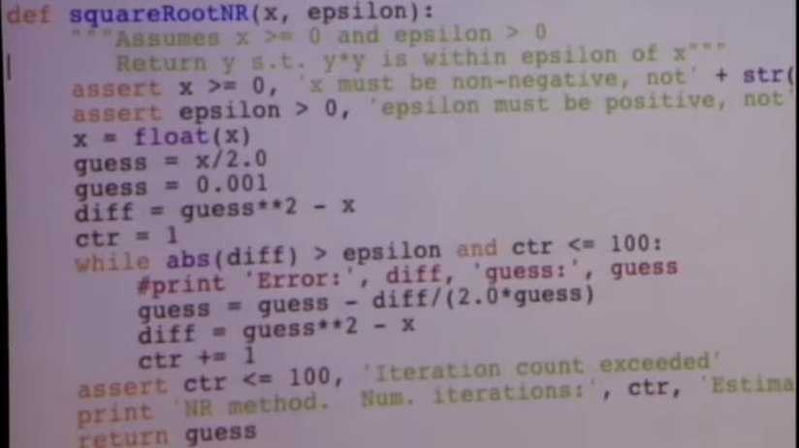
Implementation

Slide 6
Non-scalar types
Immutable
Mutable
Tuples
Strings
List

Slide 7
List
Techs = [ 'MIT' , 'Cal Tech']
Ivys = [ 'Harvard' , 'Yele', 'Brown']
Univs = [] Representation in computer memory:
Techs
Ivys
Univs
'MIT'
'Cal Tech'
'Harvard'
'Yele'
'Brown'

Slide 8
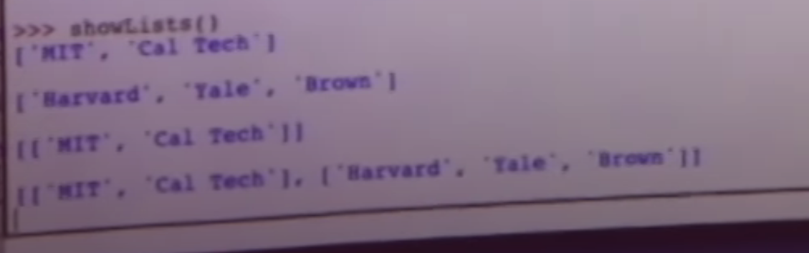
Operations with lists
Univs.append (Techs)
Print Univs
Univs.append (Ivys)
Print Univs
Functions such as append are called methods.

Slide 9
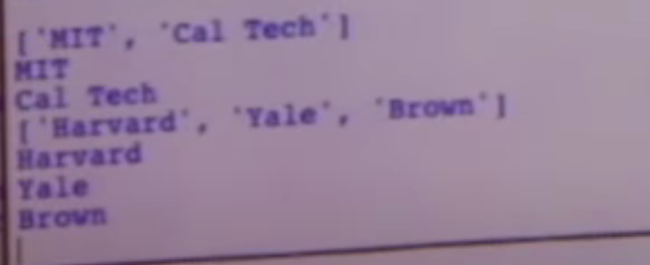
For e in Univs:
Print e
For c in e: print c

Slide 10
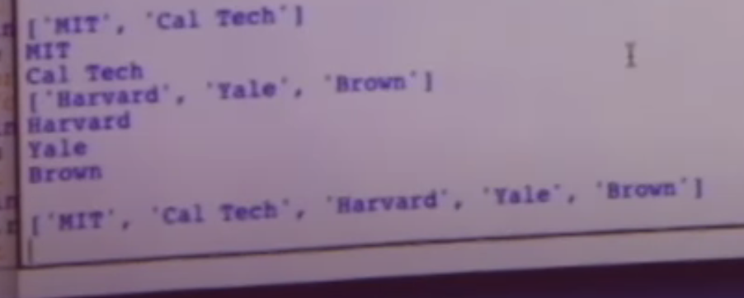
Univs = Techs + Ivys
Print Univs

Slide 11
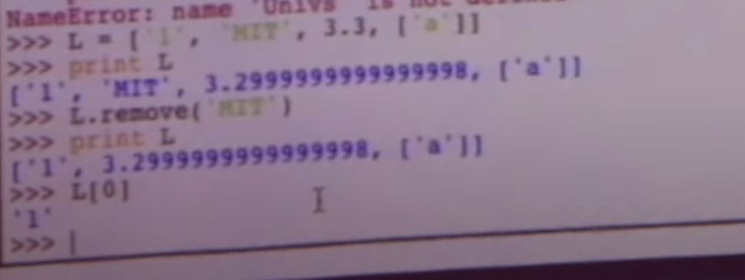

Slide 12
Thank you for your attention!

